Slide 1

VSLA
Village Saving Loans Associations
(Saving and Credit Groups - SCGs)

Slide 2
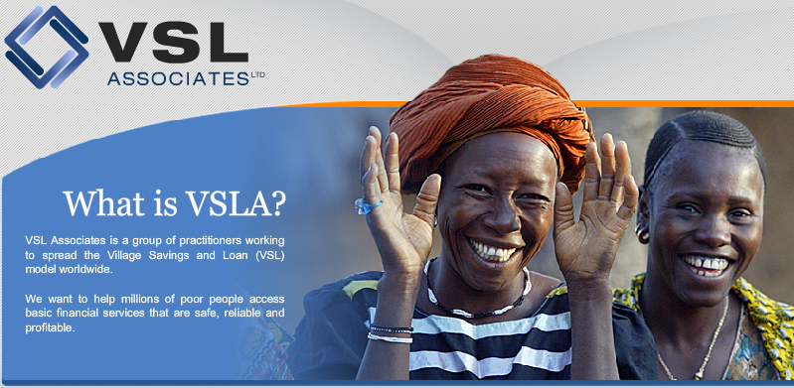
Saving and Credit Groups
What is VSLA?
Methodology for saving and lending money among group members
It is born in West Africa and has been practiced and evaluated for over 30 years. Several organizations are using this methodology in the Philippines since long ago.
It is used by many organizations and it is funded by several donors
All the tools and materials needed to be implemented already exist
http://www.vsla.net/

Slide 3
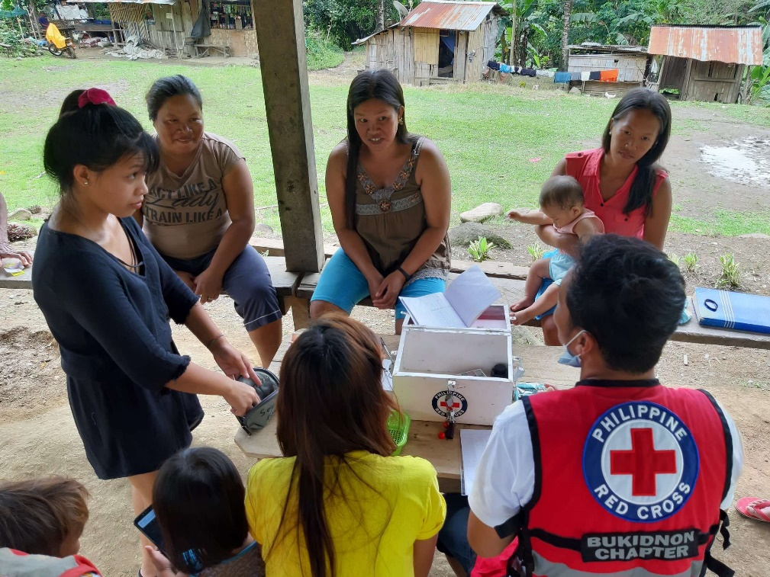
Saving and Credit Groups
What are VSLA main characteristics?
No bureaucracy
Replicable
Low Cost – High Impact
Safe, Reliable and Profitable
Suitable for illiterate population
100% Self-Managed: highly sustainable
No dependency/economic loss on financial institutions
Suitable for vulnerable population in exclusion situations

Slide 4
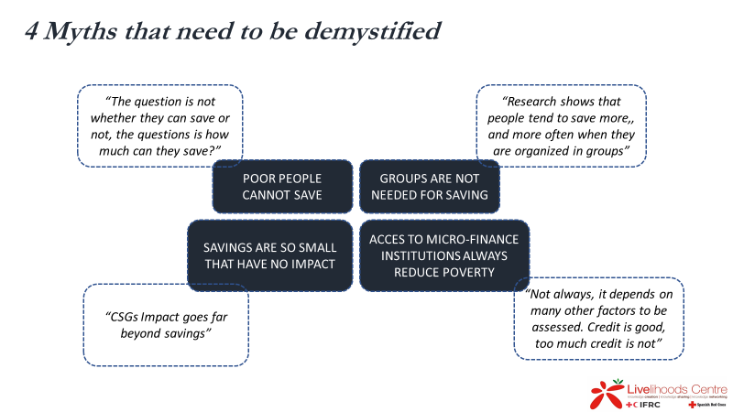
Saving and Credit Groups

Slide 5

Saving and Credit Groups
How do we know that it is a successful methodology?
98% of members continue from one annual cycle to the next
89% of groups continue to operate more than five years after receiving training, on average doubling their capitalization and average loan sizes
At any one time 74% of the available funds are in circulation as loans
High annual return on assets
Loan Repayment rates are the highest in the microfinance industry
Women comprise 78% of the membership

Slide 6
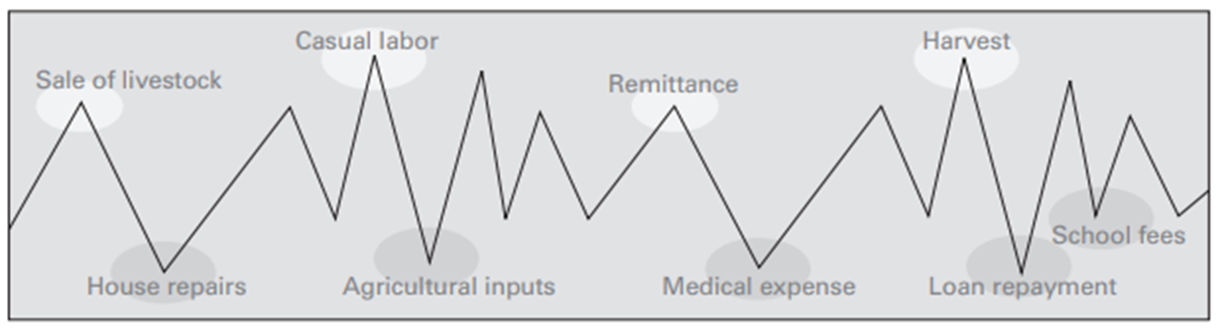
Saving and Credit Groups
Why is Saving important for vulnerable families?
Families income and expenditure fluctuates along the year
An additional expenditure (accident, illness, disaster, etc.) in the wrong moment can jeopardize the family economy for a long time: indebtedness and other high-risk coping strategies
Saving and Credit groups stabilizes this fluctuation

Slide 7
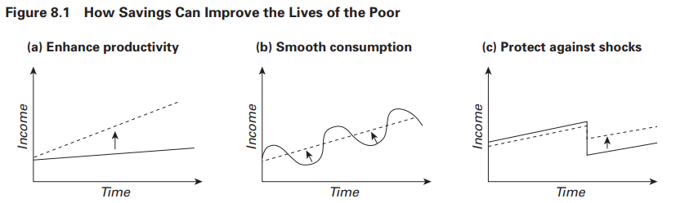
Saving and Credit Groups

Slide 8
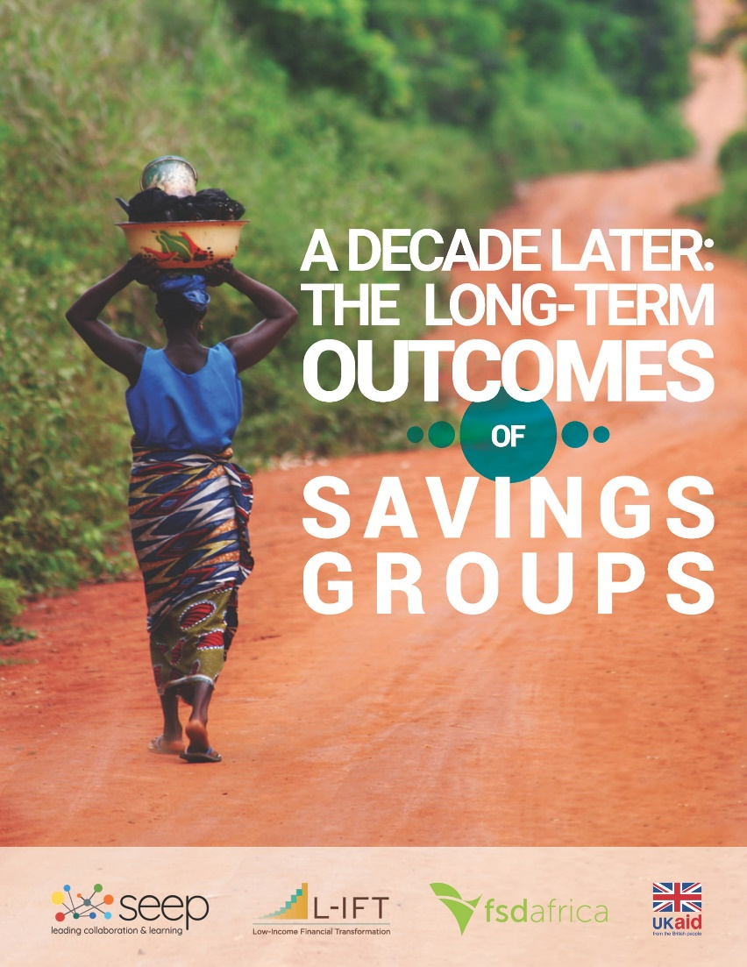
Village Saving Loans Associations
What is VSLA Impact?
Livelihoods
Food Security
Women Economic Empowerment
Mental health and Self-confidence
Resiliency / Inclusion / Emancipation

Slide 9
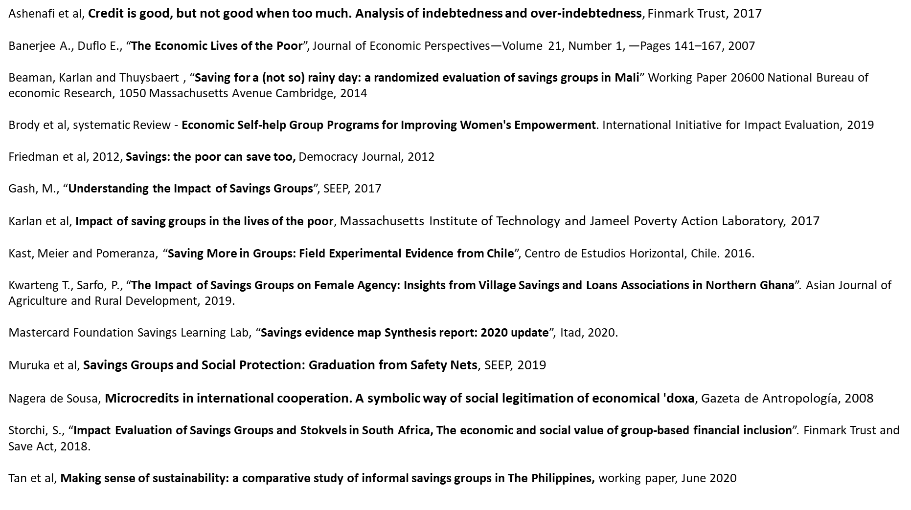
Don’t believe it… Check it out!
Saving and Credit Groups

Slide 10
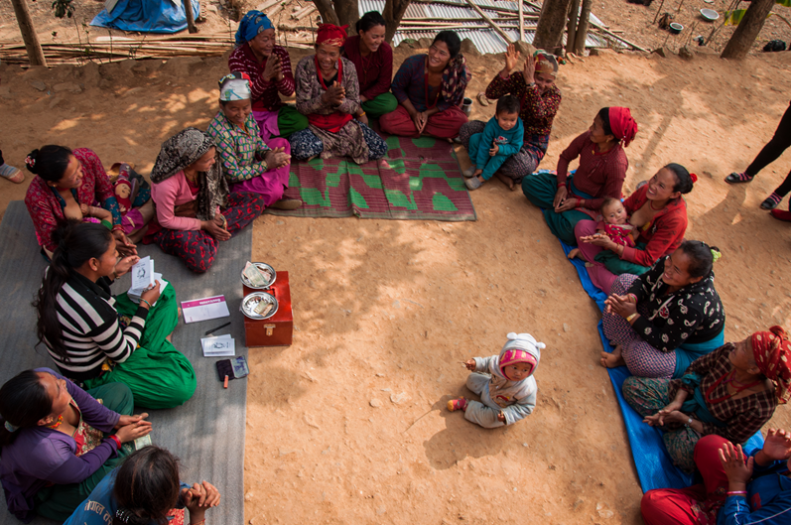
Saving and Credit Groups
How does it function?
Between 10-25 people in a group committed to save money
They are self-managed – taking decisions from day 1
They choose their own Committee (5 people)
They are trained during their first saving cycle – learning by doing-
The first saving cycle lasts between 36-52 weeks – they meet every week
They save money by buying saving shares (1-5) in each meeting
The money is kept in a safe box with 3 locks
They contribute to a social fund for calamities
The money that is being saved is used for loans among the members
Loans have interests that are decided by the group
All members have their own Passbook recording their economic activity
At the end of the cycle, each member gets their savings back with revenue

Slide 11
Saving and Credit Groups
What is VSLA Impact?
Livelihoods
Food Security
Women Economic Empowerment
Mental health and Self-confidence
Resiliency / Inclusion / Emancipation

Slide 12
Saving and Credit Groups

Slide 13
Saving and Credit Groups
What is VSLA Impact?
Livelihoods
Food Security
Women Economic Empowerment
Mental health and Self-confidence
Resiliency / Inclusion / Emancipation

Slide 14
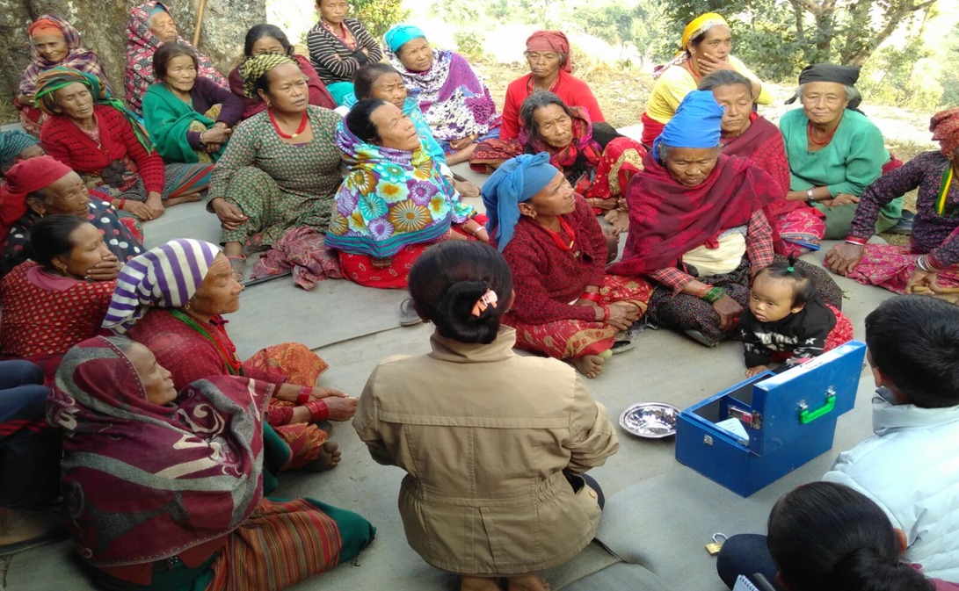
Saving and Credit Groups
What do the groups learn?
Module 1: General Assembly, Management Committee and Elections
Module 2: Setting policies & rules: social fund, share-purchase/savings and credit
Module 3: Development of Group Constitution
Module 4: Record-keeping and how to manage a share-purchase/savings meeting
Module 5: First share-purchase/savings meeting
Module 6: First loan disbursement meeting
Module 7: First loan repayment meeting
Module 8: Share-out/action-audit and graduation

Slide 15
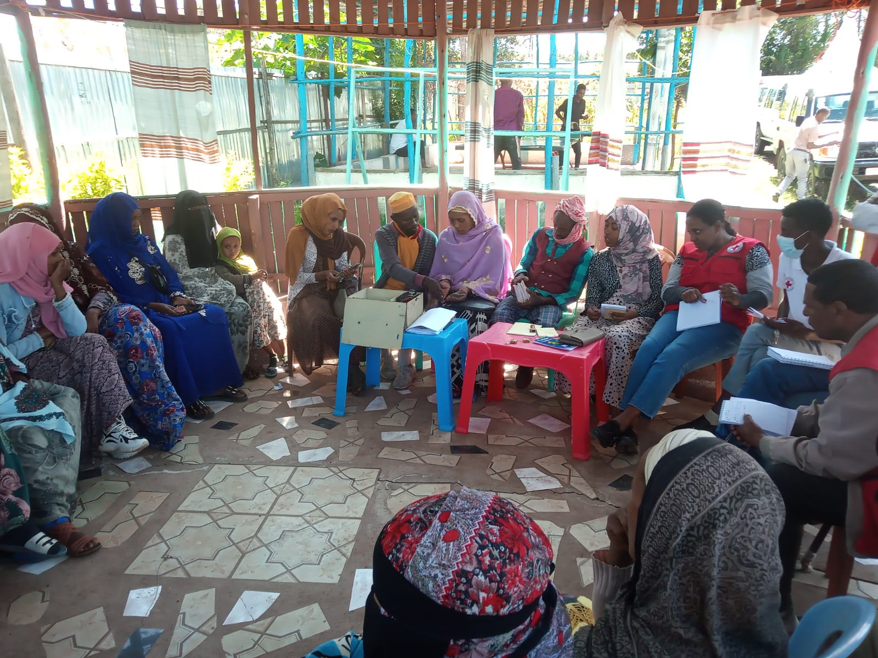
Saving and Credit Groups
Keys for Success
Trust
Team spirit
Living nearby
A common bond
Similar saving capacity
A clear saving objective
Field Staff
NEED TO FOLLOW THE GUIDELINES

Slide 16
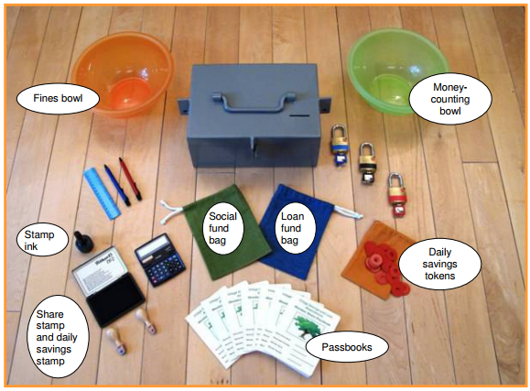
What are the Available Resources?
Saving and Credit Groups
VSLA training videos - VSLA
SAVING KIT

Slide 17
Thank you

